Slide 1
Discrete Structures
Truth Tables

Slide 2
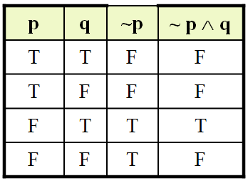
Truth table for the statement form ~ p ∧ q

Slide 3
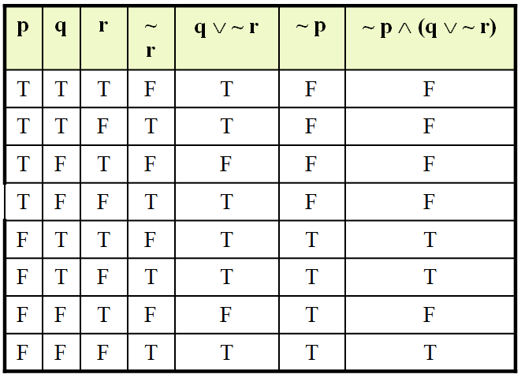
Truth table for ~ p ∧ (q ∨ ~ r)

Slide 4
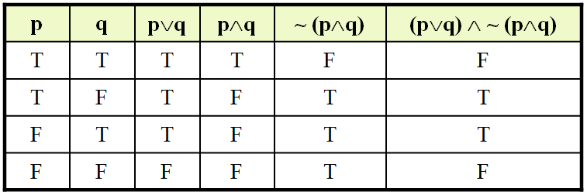
Truth table for (p∨q) ∧ ~ (p∧q)

Slide 5
Logic
Double Negative Property ~(~p) ≡ p

Slide 6
Logic
Double Negative Property ~(~p) ≡ p
p | ~p | ~(~p)
T | F | T
F | T | F

Slide 7
Example
“It is not true that I am not happy”
Solution:
Let p = “I am happy”
then ~ p = “I am not happy”
and ~(~ p) = “It is not true that I am not happy”
Since ~ (~p) ≡ p
Hence the given statement is equivalent to: “I am happy”

Slide 8
Truth Table
USAGE OF “OR” IN ENGLISH
In English language the word or is sometimes used in an inclusive sense (p or q or both).
Example: I shall buy a pen or a book.
In the above statement, if you buy a pen or a book in both cases the statement is true and if you buy (both) pen and book then statement is again true. Thus we say in the above statement we use or in inclusive sense.

Slide 9
Truth Table
The word or is sometimes used in an exclusive sense (p or q but not both). As in the below statement.
Example: Tomorrow at 9, I’ll be in Lahore or Islamabad.
Now in above statement we are using or in exclusive sense because both the statements are true then we have F for the statement.
While defining a disjunction the word or is used in its inclusive sense. Thus the symbol ∨ means the “inclusive or”

Slide 10
Truth Table
EXCLUSIVE OR
When or is used in its exclusive sense, the statement “p or q” means “p or q but not both” or “p or q and not p and q” which translates into symbols as:
(p ∨ q) ∧ ~ (p ∧ q)
Which is abbreviated as: p ⊕ q
or p XOR q

Slide 11
Truth Table
TRUTH TABLE FOR EXCLUSIVE OR
(p ∨ q) ∧ ~ (p ∧ q) is logically equivalent to
p ⊕ q

Slide 12
Truth Table
TRUTH TABLE FOR EXCLUSIVE OR
p | q | p∨q | p∧q | ~ (p∧q) | (p∨q) ∧ ~ (p∧q)
T | T | T | T | F | F
T | F | T | F | T | T
F | T | T | F | T | T
F | F | F | F | T | F

Slide 13
~ (p∧q) and ~p ∧ ~q are not logically equivalent

Slide 14
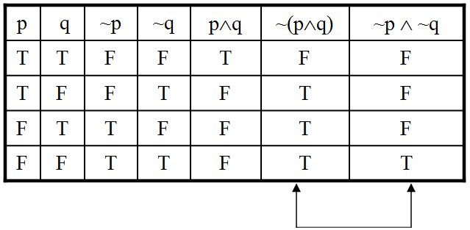
~ (p∧q) and ~p ∧ ~q are not logically equivalent

Slide 15
Truth Tables
~(p ∨ q) ≡ ~p ∧ ~q

Slide 16
Truth Tables
~(p ∨ q) ≡ ~p ∧ ~q
p | q | ~p | ~q | p ∨ q | ~(p ∨ q) | ~p ∧ ~q
T | T | F | F | T | F | F
T | F | F | T | T | F | F
F | T | T | F | T | F | F
F | F | T | T | F | T | T

Slide 17
Truth Tables
DE MORGAN’S LAWS
1) The negation of an and statement is logically equivalent to the or statement in which each component is negated. Symbolically ~(p ∧ q) ≡ ~p ∨ ~q.
2) The negation of an or statement is logically equivalent to the and statement in which each component is negated. Symbolically: ~(p ∨ q) ≡ ~p ∧ ~q.

Slide 18
Truth Tables
Application
Give negations for each of the following statements:
The fan is slow or it is very hot.
Akram is unfit and Saleem is injured.
Solution
The fan is not slow and it is not very hot.
Akram is not unfit or Saleem is not injured.

Slide 19
Truth Tables
TAUTOLOGY
A tautology is a statement form that is always true regardless of the truth values of the statement variables.
A tautology is represented by the symbol “T”.

Slide 20
Truth Tables
EXAMPLE
The statement form p ∨ ~ p is tautology
p ∨ ~p ≡ t

Slide 21
Truth Tables
EXAMPLE
The statement form p ∨ ~ p is tautology
p ∨ ~p ≡ t
p | ~ p | p ∨ ~ p
T | F | T
F | T | T

Slide 22
Truth Tables
CONTRADICTION
A contradiction is a statement form that is always false regardless of the truth values of the statement variables.
A contradiction is represented by the symbol “c”.
So if we have to prove that a given statement form is CONTRADICTION we will make the truth table for the statement form and if in the column of the given statement form all the entries are F ,then we say that statement form is contradiction.

Slide 23
Truth Tables
EXAMPLE
The statement form p ∧ ~ p is a contradiction.
Since in the last column in the truth table we have F in all the entries so is a contradiction p ∧ ~p ≡c

Slide 24
Truth Tables
EXAMPLE
The statement form p ∧ ~ p is a contradiction.
Since in the last column in the truth table we have F in all the entries so is a contradiction p ∧ ~p ≡c
p | ~ p | p ∧ ~ p
T | F | F
F | T | F

Slide 25
Truth Tables
REMARKS
Most statements are neither tautologies nor contradictions.
The negation of a tautology is a contradiction and vice versa.
In common usage we sometimes say that two statements are contradictory.
By this we mean that their conjunction is a contradiction: they cannot both be true.

Slide 26
Truth Tables
LOGICAL EQUIVALENCE INVOLVING TAUTOLOGY
1. Show that p ∧ t ≡ p

Slide 27
Truth Tables
Since in the table the entries in the first and last columns are identical so we have the corresponding statement forms are Logically Equivalent that is
p ∧ t ≡ p
p | t | p ∧ t
T | T | T
F | T | F

Slide 28
Truth Tables
LOGICAL EQUIVALENCE INVOLVING CONTRADICTION
Show that p∧c ≡ c
Same truth values in the indicated columns so p∧c ≡ c

Slide 29
Truth Tables
LOGICAL EQUIVALENCE INVOLVING CONTRADICTION
Show that p∧c ≡ c
Same truth values in the indicated columns so p∧c ≡ c
p | c | p ∧ c
T | F | F
F | F | F

Slide 30
EXERCISE
Are the statements (p ∧ q) ∧ r and p ∧ (q ∧ r) logically equivalent
Are the statements (p ∧ q) ∨ r and p ∧ (q ∨ r) logically equivalent
Use truth table to show that (p ∧ q) ∨ (~p ∨(p ∧ ~q)) is a tautology.
Use truth table to show that (p ∧ ~q) ∧(~p∨q) is a contradiction.

